Slide 1
MODULAR SCULPTURE
MAKING ONE FROM MANY

Slide 2
WHAT IS A MODULE?
A MODULE IS A INDIVIDUAL UNIT WHICH IS USED IN THE CONSTRUCTION OF A LARGER STRUCTURE. THE MOST COMMON EXAMPLE OF A MODULE IS A BRICK USED TO CONSTRUCT A BUILDING.
MODULES ARE ALWAYS A UNIFORM SHAPE BUT CAN SOMETIMES VARY IN SIZE

Slide 3
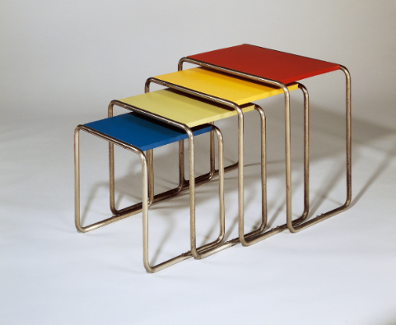
MODULES IN FURNITURE

Slide 4
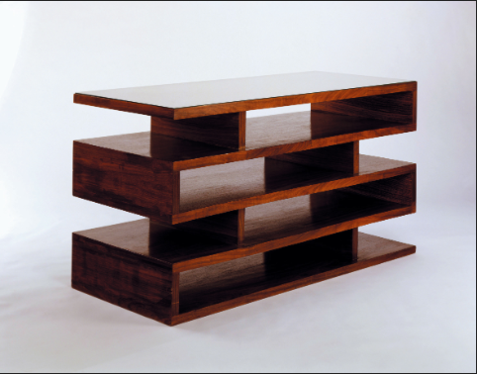

Slide 5
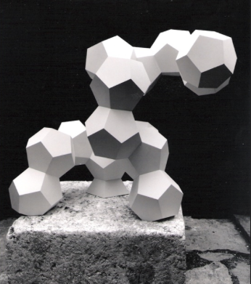
AN EXAMPLE OF MODULAR SCULPTURE

Slide 6
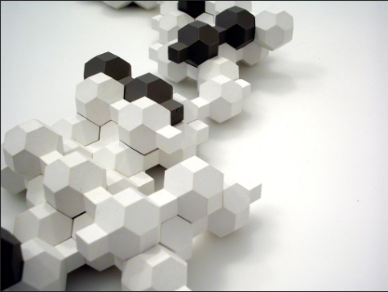

Slide 7
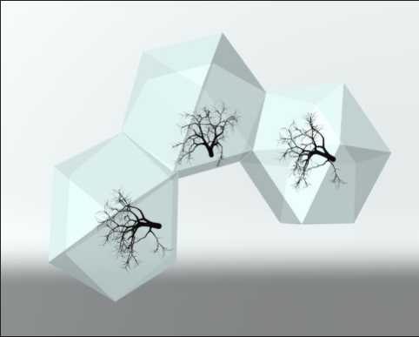

Slide 8
WHAT ARE THE MAIN THINGS WE ARE LOOKING FOR HERE?
YOUR OBJECTIVE IS TO CREATE A 3 DIMENSIONAL SCULPTURE THAT HAS A SENSE OF MOVEMENT.
MOVEMENT IS BEST ACHIEVED THROUGH THE WAY YOU CHOOSE TO PLACE YOUR MODULES AS WELL AS VARIATION IN THE SIZE OF THE MODULE.
IF THE MODULES ARE TOO UNIFORM THEY WILL BE BORING.

Slide 9
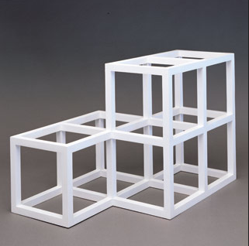
SOME ARE MORE INTERESTING THAN OTHERS

Slide 10
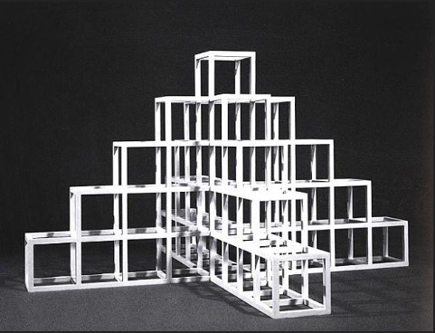
BOOOOORING!

Slide 11
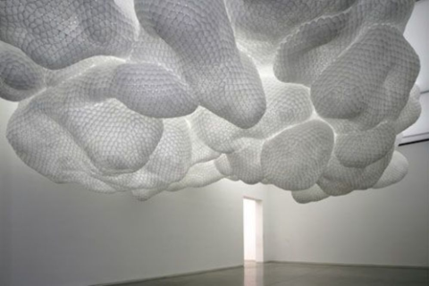
INTERESTING

Slide 12
MAIN CONSIDERATIONS
AT THIS POINT YOU WILL NEED TO DETERMINE WHICH MODULAR FORM YOU ARE GOING TO WORK WITH.
CUBES ARE THE EASIEST TO WORK WITH BUT THERE ARE MANY VARITIONS!
ONCE YOU FIND THE SHAPE YOU ARE GOING TO WORK WITH MAKE SURE YOU PRINT OUT 3 DIFFERENT SIZES AND PUT YOUR NAMES ON THEM!!! AND DON’T LOOSE THEM!!!!!!!!!

Slide 13
NEXT CLASS
WE WILL COME BACK DOWN TO THE FOUNDATIONS ROOM AND BEGIN TO TRACE, CUT, AND FOLD YOUR TEMPLATES INTO FORMS.
WE WILL BE USING CARDSTOCK PAPER SO IT IS THICKER AND STURDIER SO WHEN WE ASSEMBLE THE FORMS IT WILL HOLD UP WELL.

